Slide 1
Zones of Regulation
Tina Chadwick, School Counselor
Heather Hill, School Psychologist
Mykeia Smith, School Social Worker
Swift Creek Elementary School
Created by: Chadwick, Hill & M. Smith
Notes:
Tina and Heather - Model zone statement/check in

Slide 2
Our Why.
We teach reading, writing, and mathematics. But children also need to be taught how to identify and manage their emotions.
Since using Zones of Regulation school wide, we have seen:
Increase in students’ ability to recognize, communicate & manage their emotions
Increase in staff members’ confidence & ability to help children with their emotions
Share Zones of Regulation resources with you!
Notes:
Tina: If a student is struggling to read, do math, or write, it can increase difficulty with self-regulation. Academic difficulties can start as a result of emotional difficulties and/or emotional difficulties can start as a result of academic difficulties. We are teaching them how to deal with setbacks independently and within the school community.

Slide 3
What is Zones of Regulation or “Zones?”
Practices based on evidence
Cognitive behavior approach
Helps people recognize different emotional states called “zones”
Gives strategies, or “tools,” to stay in or move to a zone
Helps with SELF-REGULATION
Increases control and problem-solving abilities
Notes:
Heather
Zones of regulation is an evidence based curriculum geared toward helping students gain skills in consciously regulating their actions, which in turn leads to increased control and problem-solving abilities. Using a cognitive behavior approach, the curriculum helps students recognize when they are in different states called “zones,” with each of the the four zones represented by a different color. Students learn strategies, or “tools,” to stay in a zone or move from one zone to another.

Slide 4
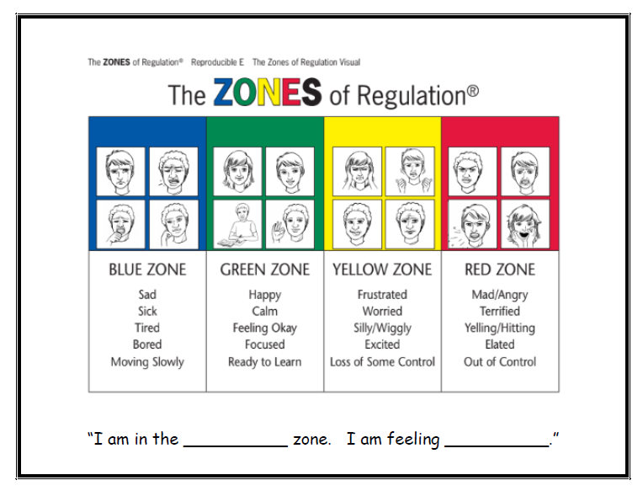
Notes:
Tina: The Zones of Regulation identifies 4 different states that we can be in emotionally. None of the zones are bad or wrong and we all experience all four of the zones. We want to help children learn how to be in a more comfortable zone, such as the green zone, the majority of the time.

Slide 5
Red Zone
Extremely heightened state of alertness or very intense feelings,
Anger/rage
Explosive behavior
Panic/ terror
Elation
NOT IN CONTROL OF BODY
Red light - “stop and regain control”
Energy Level:
Notes:
Tina

Slide 6
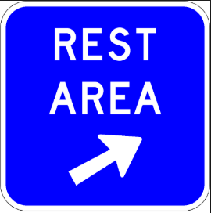
Blue Zone
Low states of alertness
Sad
Tired
Sick
Bored
BODY AND/OR BRAIN ARE MOVING SLOWLY
“A rest area where you pull over when you need to recharge”
Energy Level:
Notes:
Heather
Sluggish

Slide 7
Yellow Zone
Elevated emotions and heightened state of alertness
Stress
Frustration
Anxiety
Excitement
Silliness
Nervousness
Confusion
STARTING TO LOSE CONTROL OF BODY
Yellow light - “slow down or take warning”
Energy Level:
Notes:
Tina
Some control of body and emotions still but could elevated to losing control/red zone
BODY FEELS WIGGLY, SQUIRMY, OR SENSORY SEEKING

Slide 8
Green Zone
A regulated state of alertness
Calm
Happy
Focused
Content
Ready to Learn
IN CONTROL OF BODY
Green light – “good to go”
Energy Level:
Notes:
Heather
This is the zone for which students typically need to be in for school work and being social

Slide 9
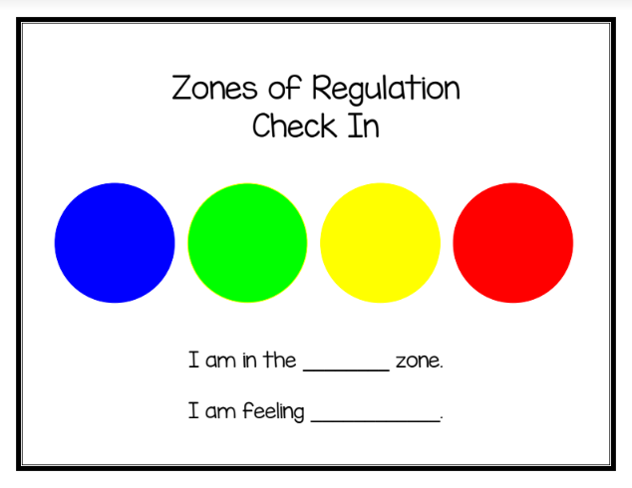
ZONES Check-In
Guide children through stating their zone and feelings.
If they can’t say it,
they can point.
Model this language
Notes:
Tina

Slide 10
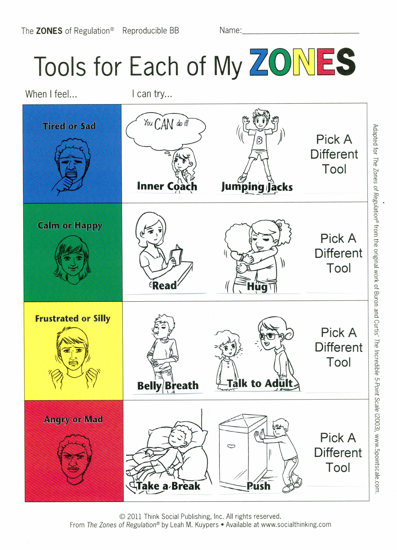
Tools
Guide the children to use appropriate tools for zone
Each person will go through a process of figuring out which tools work for them in each zone.
Notes:
Heather
Tools
No right or wrong selections but appropriate or inappropriate-yes. Each person goes through a process of figuring out which tools work for them in each zone.
Our tools menu is a guide. They don’t have to choose a tool listed in the exact zone it appears on the menu. They can also create their own menus or you can add to your class menu.
Your Choice or...Blue: Inner Coach & Jumping Jacks Green: Read & Hug Yellow: Talk to Adult & Belly Breath Red: Take a Break & Push
Briefly go over the tools on our school wide tool box and ask if there are any questions about any of them
These are what we offer school wide for all students, sometimes these are a good fit for a student and the student services staff (counselor, psych, social worker) will work with small groups to help with self-reguation, tools, etc. with students when needed
Some teachers are doing optional lessons: inner critic/inner coach, size the problem

Slide 11
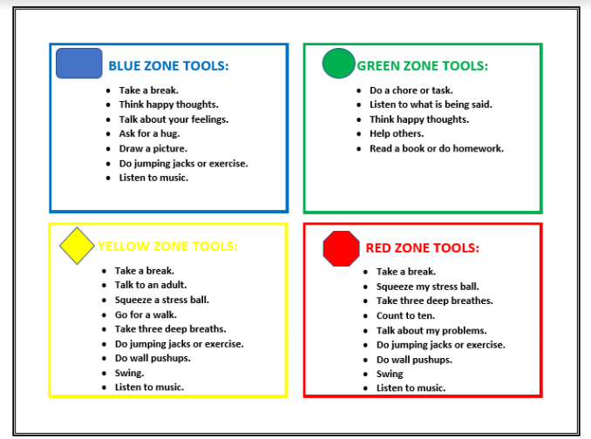
Tying It All Together
Notes:
Tina

Slide 12
Three Prongs of Social Emotional Learning (SEL) at SCES
Positive Behavioral Interventions & Supports (PBIS)
ROAR Pledge
ROAR Coupons
Class Compliments
The Positivity Project (P2)
Daily lessons
Character Strengths
Other People Matter Mindset
Zones Of Regulation
Examples of times SEL is being reinforced:
EL, Guidance Classes, Small Groups, Specials, Cafeteria, etc...
Notes:
Tina

Slide 13
What can you do at home?
Share your zone
Dinner as a family
Read the Zones portion of the PTA Newsletter
Read books together
Point out your observations of your child’s zone/Behavior
Validate your child’s zone and help them brainstorm tools
Share how your child’s behavior is impacting your zone Express interest in your child’s triggers
Positively reinforce your child for recognizing their zone
Notes:
Heather
Share your zone and what you’re going to do to move towards green zone!
Dinner as a family
PTA News letter
Read books together and talk about Zones/feelings of characters
Point out your observations of your child’s zone basedon observation
Validate the zone your child is in and hellp them brainstorm ideas to self-regualte
Share how your child’s behavior is impacting your zone and how you feel
Express interest in what triggers feelings/zones in your child
Postiively reinforce your child for reconizing their zone and managing their behaviors or showing expected behaviors for situation
Everyone experiences all zones, yellow or red zones are not bad or naughty
All zones are expected at one time or another

Slide 14
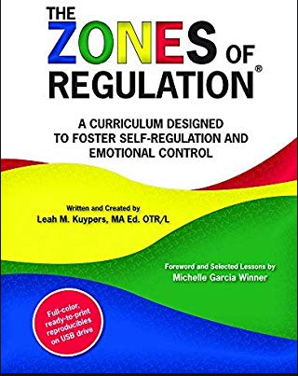
Resource
The Zones of Regulation: A Curriculum Designed to Foster Self-Regulation and Emotional Control
Written and Created by: Leah M. Kuypers, MA ED. OTR/L
Notes:
Heather

